Slide 1
Network Analyser
Network Security Mini Project
By- Agrim Ray PML2024002

Slide 2
Introduction
In the digital era, where organizations heavily depend on the internet and network infrastructures, ensuring the security of data and communication has become critical.
Network Anomaly Analyzer is being developed which can leverage capabilities of Python and Tshark to analyze network packets.
This project culminates in a graphical user interface (GUI) application that allows users to visualize network activities, capture live traffic, and classify traffic sessions as either benign or malicious.

Slide 3
Objective
To develop a machine learning-based model capable of accurately detect network traffic as normal or malicious.
To design a user-friendly GUI interface that enables real-time monitoring, classification, and visualization of network traffic.
To provide visual insights such as protocol distribution, traffic flow over time, IP address activity, port usage, and more.

Slide 4
Steps
Train and Test Random Forest Classifier on the dataset KDDCUP’99 .
Use Tshark to capture packets from the network interface.
Group packets to create sessions with similar IP’s.
Predict the results using the Trained model.
Show the results and GUI related graphs using Tkinter for user understanding.

Slide 5
Basic Dataset features
Duration: Length of time duration of the connection
Protocol_type: Protocol used in the connection
Service: Destination network service used
Flag: Status of the connection – Normal or Error
Src_bytes: Number of data bytes transferred from source to destination in single connection
Dst_bytes: Number of data bytes transferred from destination to source in single connection
Land: if source and destination IP addresses and port numbers are equal then, this variable takes value 1 else 0
Wrong_fragment: Total number of wrong fragments in this connection
Urgent: Number of urgent packets in this connection. Urgent packets are packets with the urgent bit Activated

Slide 6
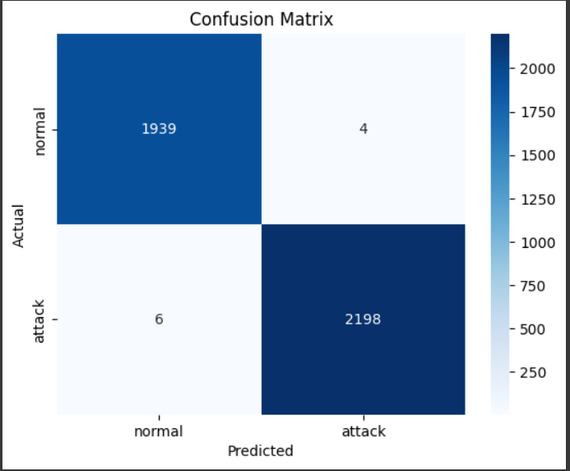
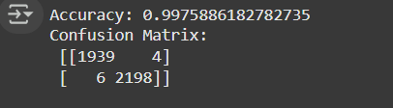
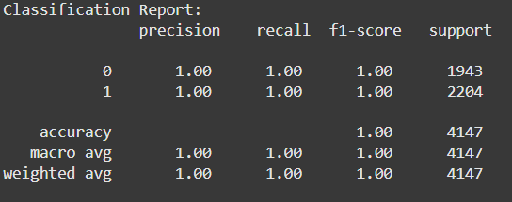
Model Results

Slide 7
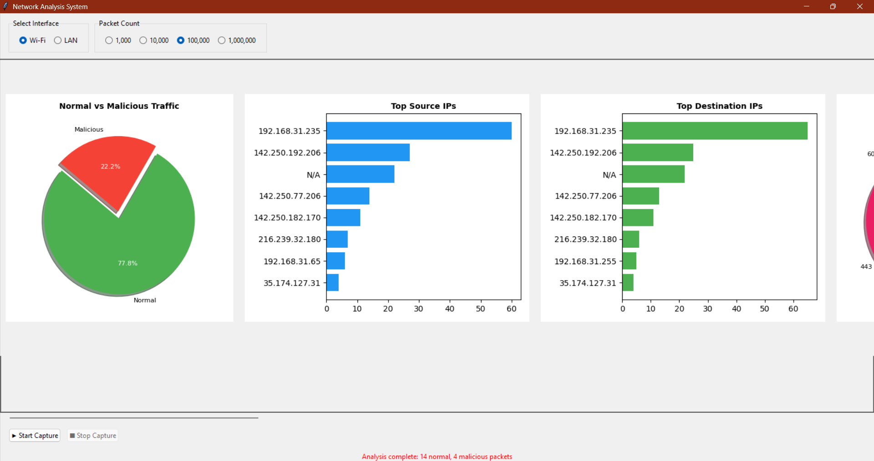
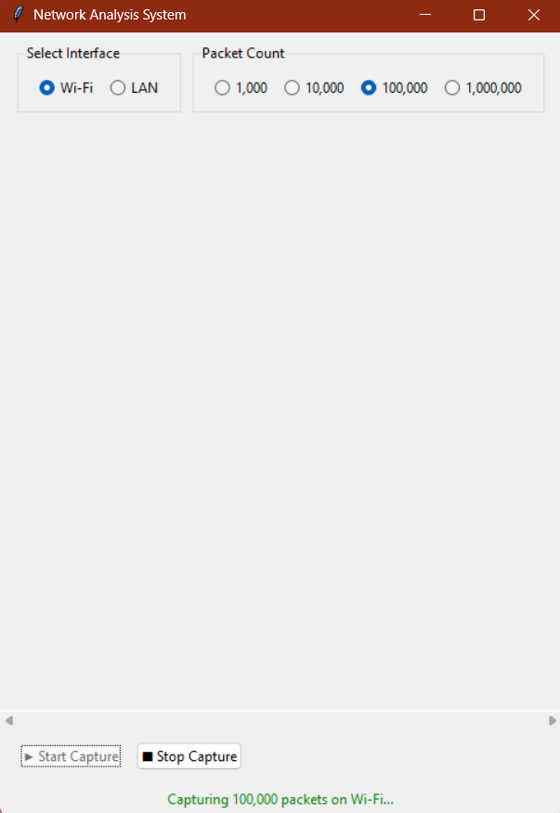
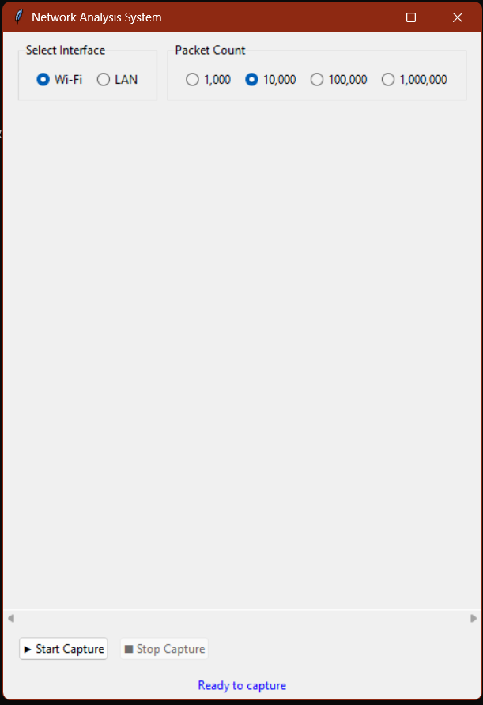
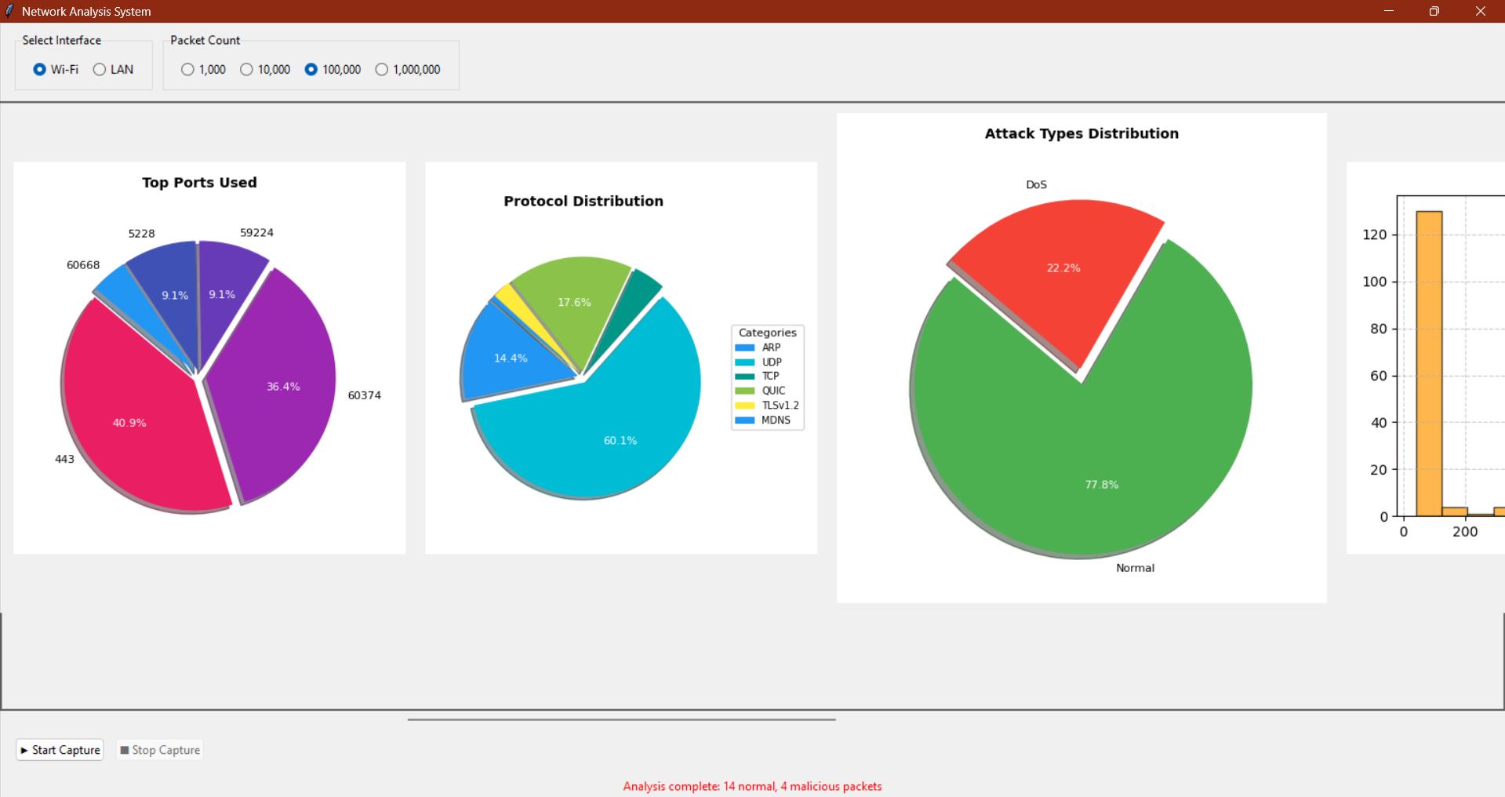
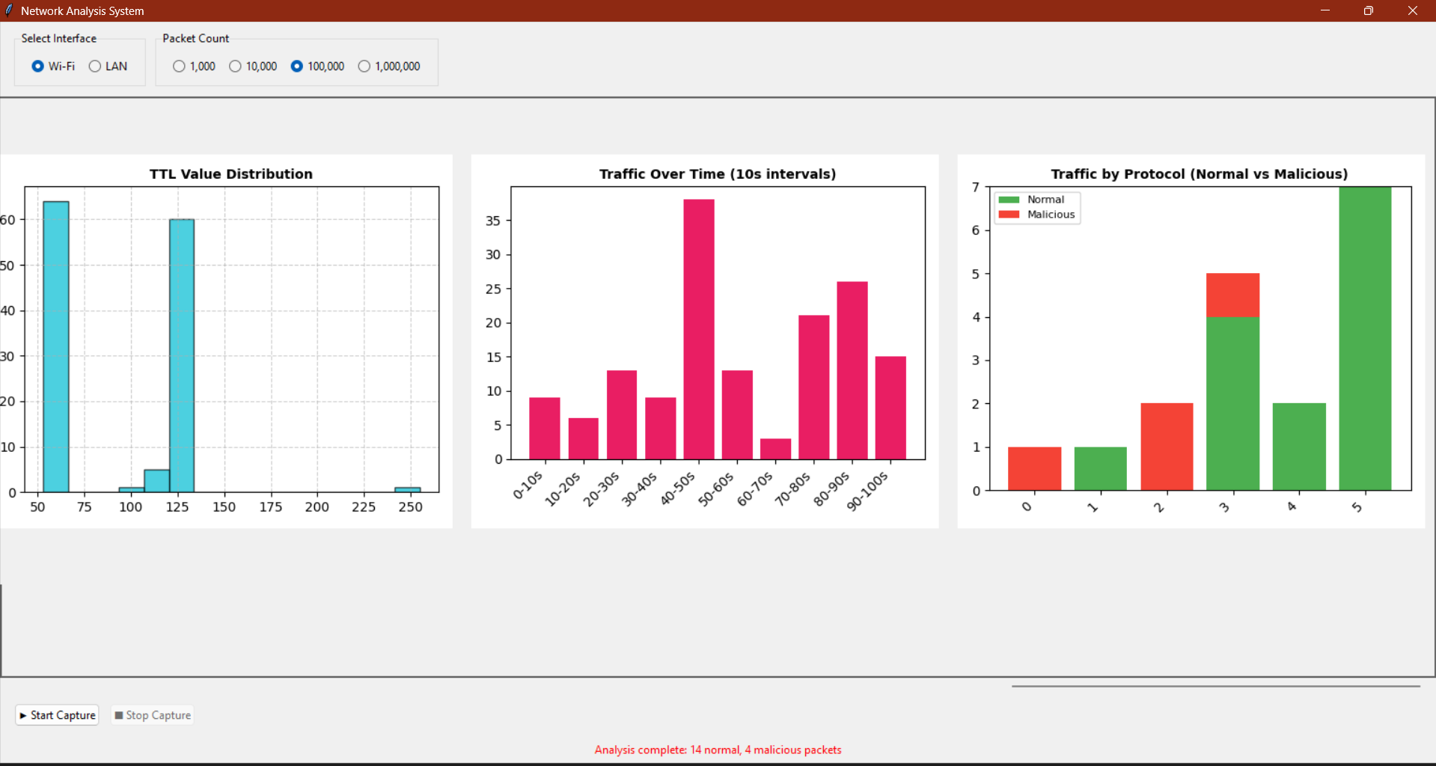
Results

